Slide 1
ANSI SQL
Understanding Constraints and their types

Slide 2

Session Objectives
At the end of the session you will be able to
Identify the various SQL constraints that a developer or tester needs to know to work with DBMS.
Define Data Integrity and Integrity Constraints.
List the types of Integrity Constraints such as PRIMARY KEY Constraint, FOREIGN KEY Constraint, NOT NULL Constraint, UNIQUE KEY Constraint, and CHECK Constraint.
Define Entity Integrity.
Define Referential, Domain, and User
Defined Integrity.

Slide 3
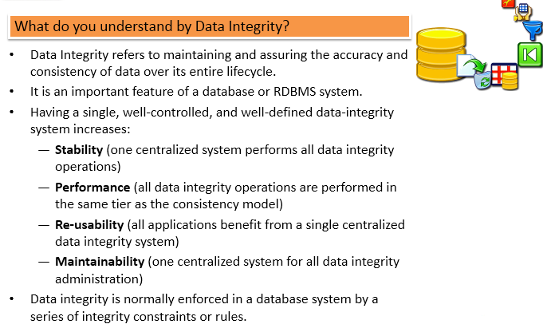
Data Integrity

Slide 4
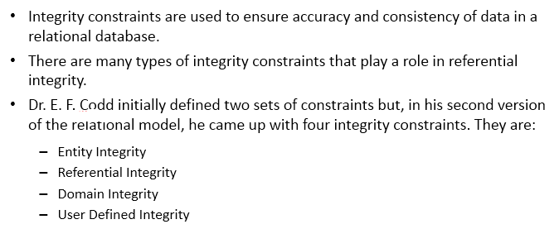
Integrity Constraints

Slide 5
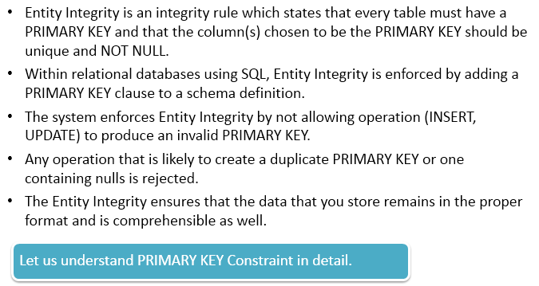
Entity Constraints

Slide 6
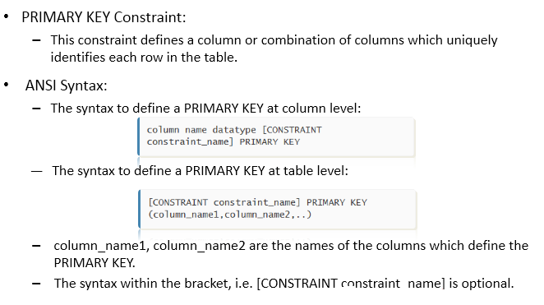
Primary key Constraints

Slide 7
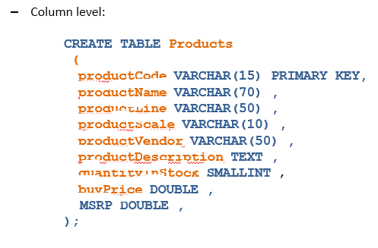
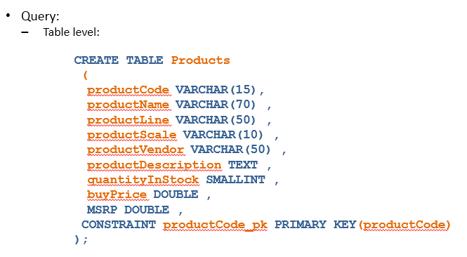
Primary key Constraints(Contd)

Slide 8
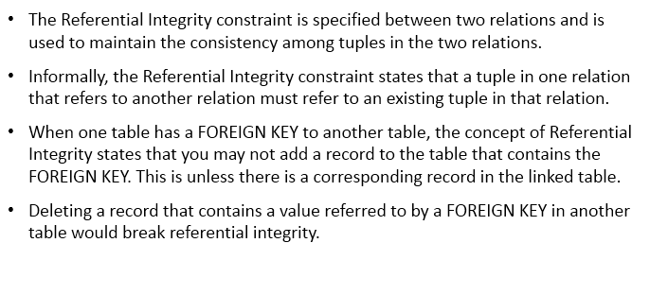
Referential Integrity

Slide 9
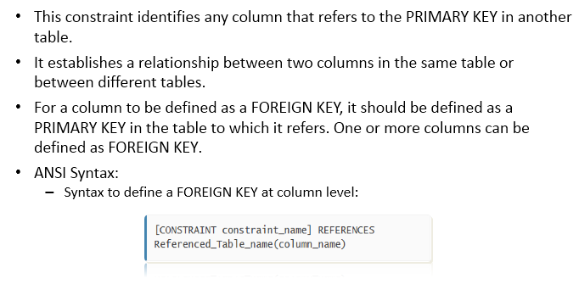
Foreign Key Constraint

Slide 10
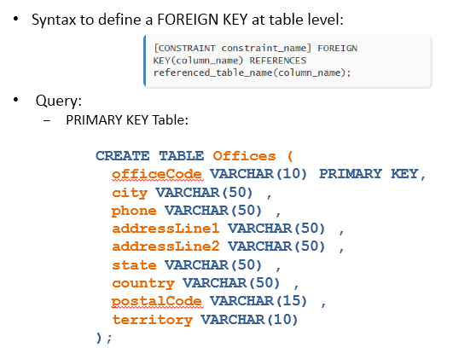
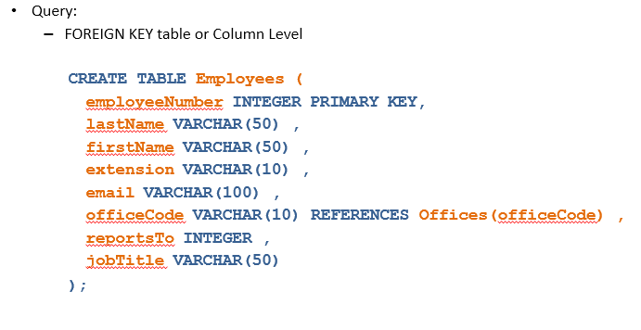
Foreign Key Constraint

Slide 11
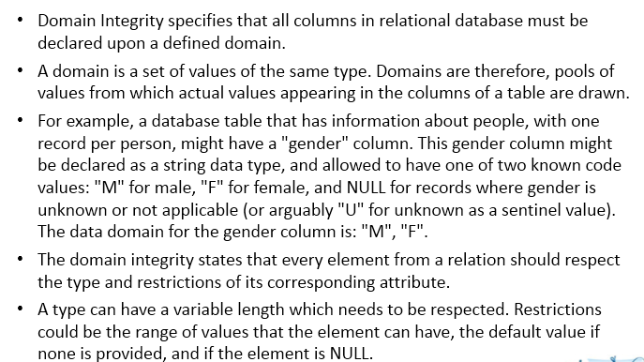
Domain Integrity

Slide 12
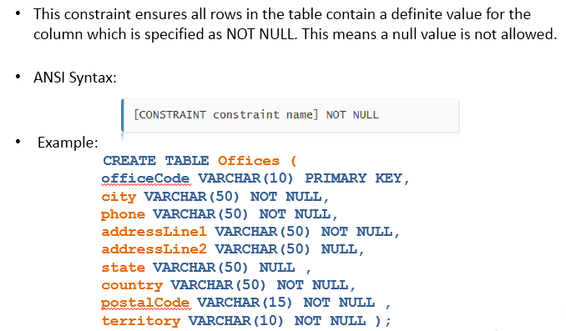
Not Null Constraint

Slide 13
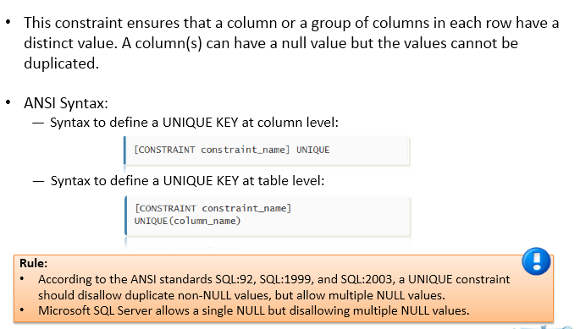
Unique Key Constraint

Slide 14
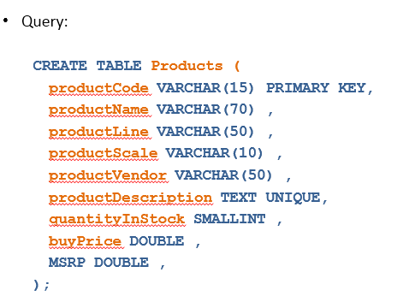
Unique Key Constraint(Contd)

Slide 15
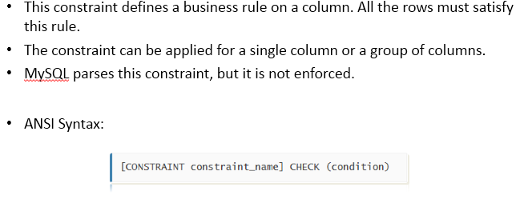
Check Constraint

Slide 16
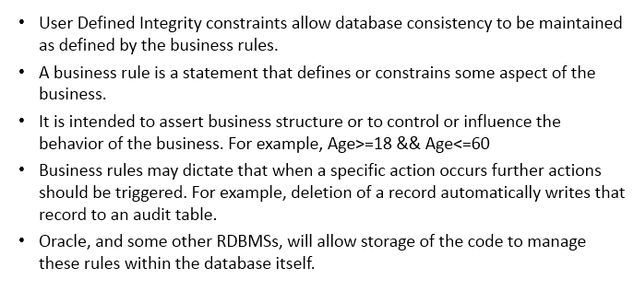
User Defined Constraint

Slide 17
You have completed Constraints and types of Constraints

